Slide 2
GGSN Commands

Slide 3
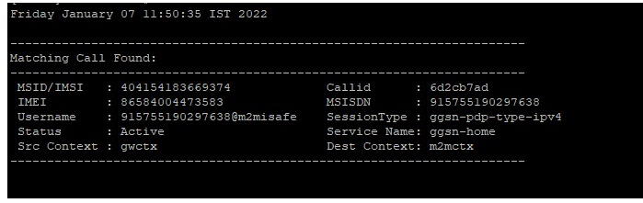
Number latched on network or not
Monitor subscriber msisdn 915755XXXXX
This command is used to check the number latched on network or not.

Slide 4
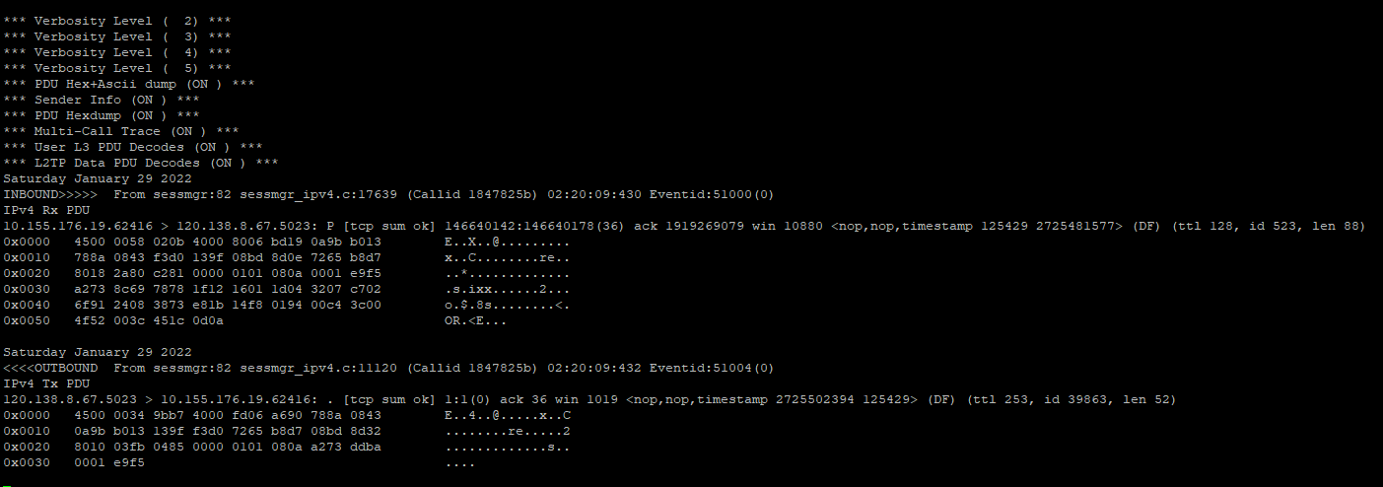
Inbound and outbound traces
++++asxy1923
This command is used to check the inbound and outbound traces.

Slide 5
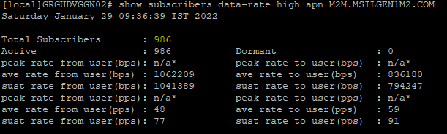
Active subscriber for APN
show subscribers data-rate high apn M2M.MSILGEN1M2.COM

Slide 6
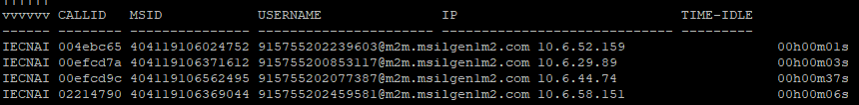
Live subscribers for APN
show subscribers apn M2M.MSILGEN1M2.COM

Slide 7
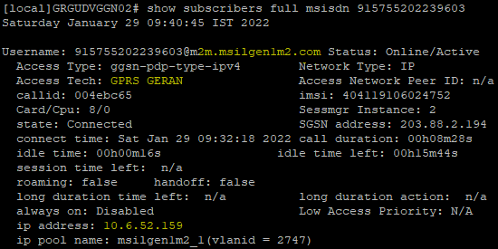
Check all details for MSISDN
show subscribers full msisdn 919643325017

Slide 8
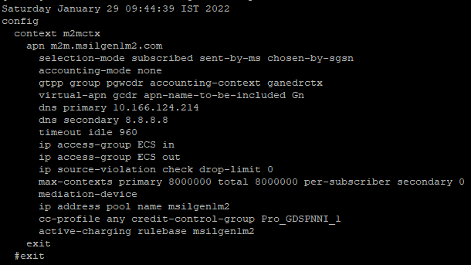
Check APN config details
show apn name M2M.MSILGEN1M2.COM

Slide 9
Check IP pool
context m2mctx
show ip pool wide
show ip pool wide | grep TPCLMUM
show ip pool group-name iot.cubg.hughes.com
show ipv6 pool summary

Slide 10
Thank you !

